Slide 1
MOLECULES and COMPOUNDS
When 2 or more atoms are joined to each other, we call it a MOLECULE.
If they are chemicals that are joined, we call it a COMPOUND.
So can you see: a COMPOUND is when 2 or more elements are joined to each other.
Examples: Making Compound called water: H + H + O → H2O
PhotoSynthesis: H + H + O + C + O + O → CH2O + O2
Respiration: C + H + H + O + O + O → H2O + CO2
See other examples on page 20.

Slide 2
SYNTHESIS REACTIONS
Scientists say this to sound smart. It just means the joining of smaller atoms together so as to build up a big compound.
ALREADY SEEN: H + H + O → H2O
MORE EXAMPLES: H + Cl → HCl
N + H + H + H → NH3
C + O + O → CO2
So you SYNTHESIZE elements into compounds through a Chemical Reaction.

Slide 3
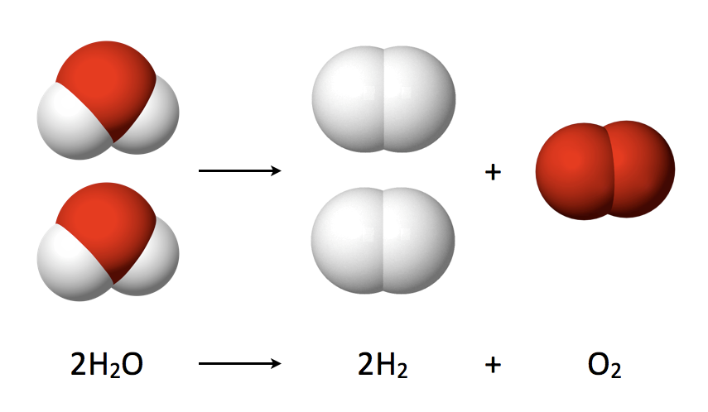
DECOMPOSITION of a COMPOUND
Yet again, scientists say this to sound smart. It just means the breaking down of a bigger compound into its simpler (smaller) elements.
EXAMPLES: Breaking down water: H2O → H + H + O
Breaking down Copper Chloride into Copper and Chlorine:
CuCl2 → Cu + Cl + Cl
So you DECOMPOSE compounds into elements in a Chemical Reaction.
We can cause these break-down reactions by: (See page 21)
Adding lots of sudden heat to the compound. (Like for KMnO4 in your book.) This is not the same as boiling it.
Electrolysing the compound (with electricity).

Slide 4
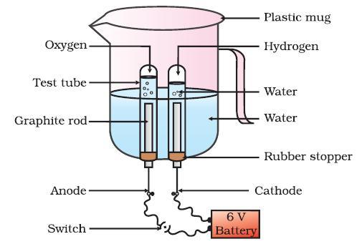
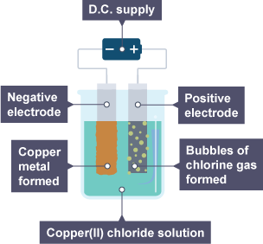
ELECTROLYSIS:
Where Electricity Breaks Down a Compound

Slide 5
QUESTIONS Pages 78-80
Question 1 [5]
1. Atoms 2. Electrons 3. Nucleons 4. Nucleus 5. Electrons
Question 2 [10]
1. Periods 2. Groups 3. Left-hand 4. Eight(teen) 5. Noble/Inert 6. Hydrogen
7. Beryllium 8. Semi-metals 9. Sulfur 10. Dmitri Mendeleev
Question 3 [28]
ELEMENT | SYMBOL | ATOMIC NUMBER | NUMBER of PROTONS | NUMBER of ELECTRONS
OXYGEN | O | 8 | 8 | 8
CARBON | C | 6 | 6 | 6
HELIUM | He | 2 | 2 | 2
MAGNESIUM | Mg | 12 | 12 | 12
SULFUR | S | 16 | 16 | 16
NITROGEN | N | 7 | 7 | 7
CHLORINE | Cl | 17 | 17 | 17

Slide 6
Question 4 [5]
N: Non-Metal 2. Pb: Metal 3. Ne: Non-Metal 4. Au: Metal 5. Na: Metal
Question 5 [5]
He: Gas 2. Cu: Solid 3. Fe: Solid 4. C: Solid 5. Hg: Liquid
Question 6
Molecule = 2 or more atoms joined together. [2]
H2 N2 O2 Cl2 [3]
Compound = 2 or more elements joined together. [2]
H2O CuCl2 CO2 NaCl [3]
Chemical bond [1]

Slide 7
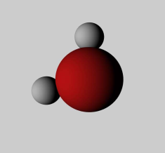
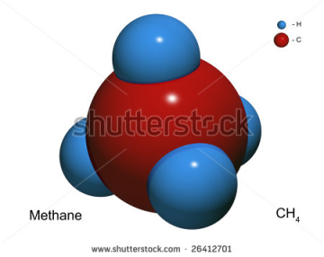
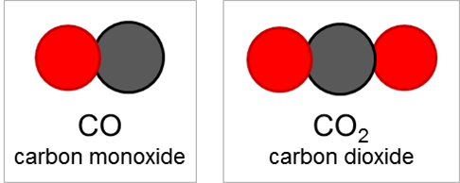
Question 7 [6]
Question 8
Thermal (heating). ElectroLysis (electricity). [2]
K (Potassium) Mn (Manganese) O (Oxygen). [3]
Oxygen. [1]
Hold glowing match in gas. If it bursts into flame with pop sound, it is Oxygen. [4]
Question 9
A = Positive (Anode) B = Negative (Cathode) [2]
C = Oxygen D = Hydrogen [2]
Compound: Has 2 elements (H + O) joined (H2O) [3]

